Slide 1
Data Representation

Slide 2
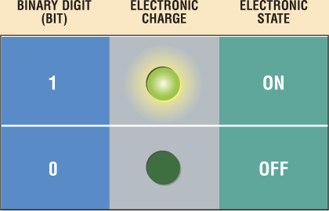
Data Representation
How do computers represent data?
Most computers are digital
Recognize only two discrete states: on or off
Use a binary system to recognize two states
Use number system with two unique digits: 0 and 1, called bits (short for binary digits)
Smallest unit of data computer can process

Slide 3
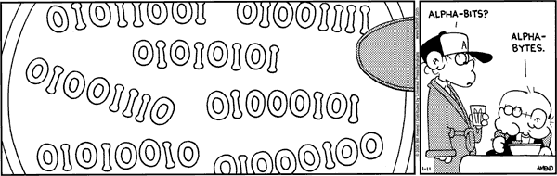

Slide 4
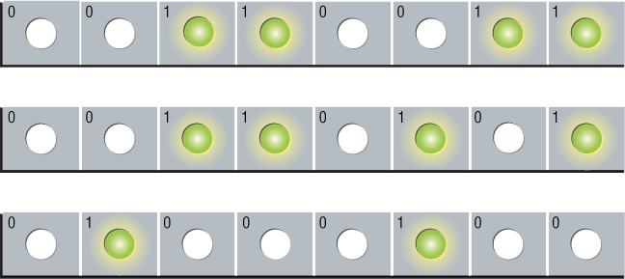
Data Representation
What is a byte?
Eight bits grouped together as a unit
Provides enough different combinations of 0s and 1s to represent 256 individual characters
Numbers
Uppercase and lowercase letters
Punctuation marks

Slide 5
Converting Binary to Decimal
Decimal number system is base 10
0, 1, 2, 3, 4, 5, 6, 7, 8, 9
Uses 10 numbers
23,625
Power of 10 representation | 10⁴ | 10³ | 10² | 10¹ | 10⁰
Decimal representation | ¹⁰⁰⁰⁰ | ¹⁰⁰⁰ | ¹⁰⁰ | ¹⁰ | ¹
Base 10 representation | ^{20,000} | ^{3,000} | ⁶⁰⁰ | ²⁰ | ⁵

Slide 6
Converting Binary to Decimal
Binary number system is base 2
0, 1
Uses 2 numbers
10010001 = 145
Base 2 representation | 2⁷ | 2⁶ | 2⁵ | 2⁴ | 2³ | 2² | 2¹ | 2⁰
Decimal representation | ¹²⁸ | ⁶⁴ | ³² | ¹⁶ | ⁸ | ⁴ | ² | ¹
Base 2 representation | ¹ | ⁰ | ⁰ | ¹ | ⁰ | ⁰ | ⁰ | ¹

Slide 7
Converting Decimal to Binary
Convert decimal 35 to binary
Using 8 bits, find largest power of 2 that will “fit” into 35
Place a 1 into that slot
If the # doesn’t fit, place a 0 into that slot
Power of 2 representation | 2⁷ | 2⁶ | 2⁵ | 2⁴ | 2³ | 2² | 2¹ | 2⁰
Decimal representation | ¹²⁸ | ⁶⁴ | ³² | ¹⁶ | ⁸ | ⁴ | ² | ¹
Base 2 representation
0
0
1
0
0
0
1
1
35 = 00100011

Slide 8
Convert Binary to Decimal
Choose an 8 bit binary number = 10101110
Write the binary digits under the correct column
For each column with a 1, you will add that decimal value
You will not add the values of the columns you entered 0
Power of 2 representation | 2⁷ | 2⁶ | 2⁵ | 2⁴ | 2³ | 2² | 2¹ | 2⁰
Decimal representation | ¹²⁸ | ⁶⁴ | ³² | ¹⁶ | ⁸ | ⁴ | ² | ¹
Base 2 representation | ¹ | ⁰ | ¹ | ⁰ | ¹ | ¹ | ¹ | ⁰
128 + 32 + 8 + 4 + 2 = 174
10101110 = 174

Slide 9
Data Representation
What are three popular coding systems to represent data?
ASCII—American Standard Code for Information Interchange
EBCDIC—Extended Binary Coded Decimal Interchange Code
Unicode—coding scheme capable of representing all world’s languages
ASCII Symbol EBCDIC
00110000 0 11110000
00110001 1 11110001
00110010 2 11110010
00110011 3 11110011

Slide 11
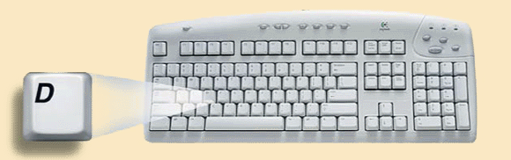
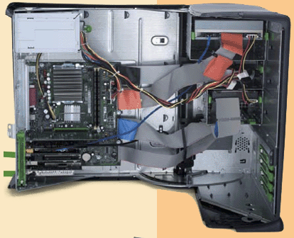
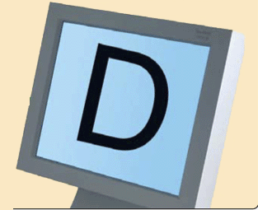
Data Representation
How is a letter converted to binary form and back?
Step 1. The user presses the capital letter D (shift+D key) on the keyboard.
Step 2. An electronic signal for the capital letter D is sent to the system unit.
Step 4. After processing, the binary code for the capital letter D is converted to an image, and displayed on the output device.
Step 3. The signal for the capital letter D is converted to its ASCII binary code (01000100) and is stored in memory for processing.

Slide 12
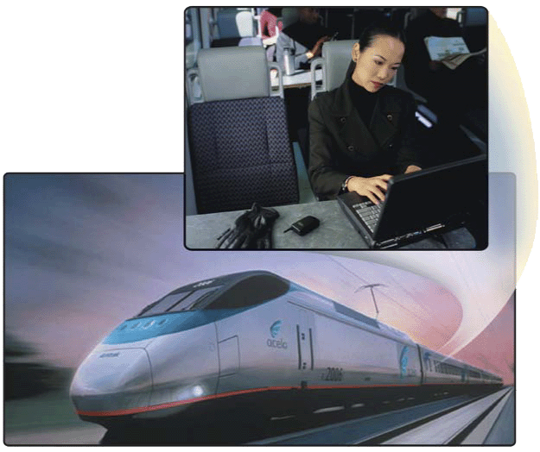
Memory
What is memory?
Seat #2B4
Seat #2B3
Electronic components that store instructions, data, and results
Consists of one or more chips on motherboard or other circuit board
Each byte stored in unique location called an address, similar to addresses on a passenger train

Slide 13
Memory
Stores three basic categories of items:
OS and system software
Application programs
Data and information
Byte is basic storage unit in memory
To access data or instructions in memory, computer references the address that contain the bytes of data
Manufacturers state the size of memory and storage devices in terms of number of bytes available

Slide 14
Memory
How is memory measured?
By number of bytes available for storage
KB = 1024 bytes
Term Abbreviation Approximate Size
Kilobyte KB or K 1 thousand bytes
Megabyte MB 1 million bytes
Gigabyte GB 1 billion bytes
Terabyte TB 1 trillion bytes

Slide 15
Name | Abbr. | Size
Kilo | K | 2^10 = 1,024
Mega | M | 2^20 = 1,048,576
Giga | G | 2^30 = 1,073,741,824
Tera | T | 2^40 = 1,099,511,627,776
Peta | P | 2^50 = 1,125,899,906,842,624
Exa | E | 2^60 = 1,152,921,504,606,846,976
Zetta | Z | 2^70 = 1,180,591,620,717,411,303,424
Yotta | Y | 2^80 = 1,208,925,819,614,629,174,706,176

Slide 16
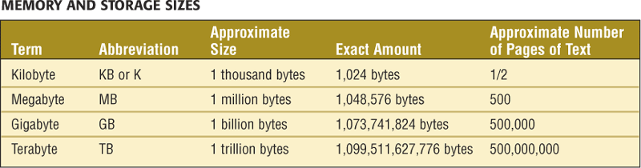

Slide 17
Number Systems
Number systems are very important to understand because the design and organization of a computer depends on the number systems. The four kind of number system used by the digital computer –
Decimal number system
Binary number system
Octal number system
Hexadecimal number system

Slide 18
Decimal Number System
The decimal number system consists of 10 digits namely 0 to 9.
Since the decimal number system consists of 10 digits, the base or radix of this system is 10.
e.g (405)₁₀ , (145.25)₁₀

Slide 19
Octal Number System
The octal number system consists of 8 digits namely 0 to 7.
Since the Octal number system consists of 8 digits, the base or radix of this system is 8.
e.g (76)₈ , (55.25)₈

Slide 20
Binary Number System
The binary number system consists of 2 digits namely 0 and 1.
Since the binary number system consists of 2 digits, the base or radix of this system is 2.
e.g (101)₂ , (1001.11)₂

Slide 21
Hexadecimal Number System
The Hexadecimal number system, popularly known as Hex system has 16 symbols, therefore its base/radix in 16.
The 16 symbols used in Hexadecimal system are 0,1,2,3,4,5,6,7,8,9,A,B,C,D,E,F
e.g (45)₁₆, (11A)₁₆

Slide 22
Conversion between Number Systems
Decimal into Binary
Step 1. Divide the decimal number by the base of binary using the repeated-division method.
Step 2. Note the remainder separately.
Step 3. Arrange the remainder in an order where the first remainder noted is LSD and the last remainder is MSD.

Slide 23
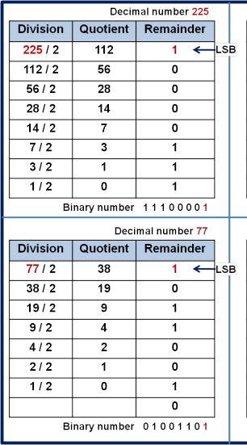
Conversion between Number Systems
Decimal into Binary (Contd…)

Slide 24
Conversion between Number Systems
Decimal into Octal
Step 1. Divide the decimal number by the base of octal using the repeated-division method.
Step 2. Note the remainder separately.
Step 3. Arrange the remainder in an order where the first remainder noted is LSD and the last remainder is MSB.

Slide 25
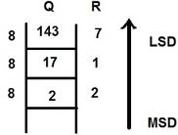
Conversion between Number Systems
Decimal into Octal (Contd…)

Slide 26
Conversion between Number Systems
Decimal into Hexadecimal
Step 1. Divide the decimal number by the base of Hexadecimal using the repeated-division method.
Step 2. Note the remainder separately.
Step 3. Arrange the remainder in an order where the first remainder noted is LSD and the last remainder is MSB.

Slide 27
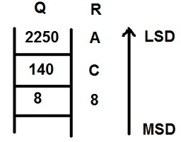
Conversion between Number Systems
Decimal into Hexadecimal (Contd…)
16
16

Slide 28
Conversion between Number Systems
Decimal real number into Binary, Octal and Hexadecimal
Step 1. Multiply the fractional part by the base of the numbers system (2, 8 or 16).
Step 2. Remove the whole number from the product (the result of the multiplication) and collect it separately.
Step 3. Repeat the step 1 and 2 with the new fractional part till the fractional part becomes zero.

Slide 29
Conversion between Number Systems
Binary to Decimal
Any binary number can be converted into decimal number using the weights assigned to each bit.
e.g. (11011)₂
Its decimal equivalent is
1x2⁴+1x2³+0x2²+1x2¹+1x2⁰ = (27)₁₀

Slide 30
Conversion between Number Systems
Binary to Octal
Indirect Method:
Binary → Decimal → Octal
e.g. (11011)₂
Its decimal equivalent is
1x2⁴+1x2³+0x2²+1x2¹+1x2⁰ = (27)₁₀
And its Octal equivalent is (33)₈ ^{(division method)}

Slide 31
Conversion between Number Systems
Binary to Octal (Contd…)
2. Direct Method
Binary → Octal
Step 1: Make the group of 3-bits from right to left for integer from left to right for fraction.
Step 2: Find decimal equivalent of each group.
Note: if the left most group (in integer) and the right most group (in fraction) present with less than 3-bits make that group by adding one or two zeros.

Slide 32
Conversion between Number Systems
Binary to Octal (Contd…)
Direct Method: e.g.
Binary → Octal
e.g. (101111)2 = (? )₈
(101111)₂ = (57)₈

Slide 33
Conversion between Number Systems
Binary to Hexa
Indirect Method:
Binary → Decimal → Hexa
e.g. (11011)₂
Its decimal equivalent is
1x2⁴+1x2³+0x2²+1x2¹+1x2⁰ = (27)₁₀
And its Hexa equivalent is (1B)_{16 (Division method)}

Slide 34
Conversion between Number Systems
Binary to Hexa
2. Direct Method:
Binary → Hexa
Step 1: Make the group of 4-bits from right to left for integer from left to right for fraction.
Step 2: Find decimal equivalent of each group.
Note: if the left most group (in integer) and the right most group (in fraction) present with less than 4-bits make that group by adding one, two or three zeros.

Slide 35
Conversion between Number Systems
Binary to Hexa
Direct Method: e.g.
Binary → Hexa
e.g. (101111)₂ = (? )₁₆
(0010 1111)₂ = (215)₁₆ = (2F)₁₆

Slide 36
Conversion between Number Systems
Octal to Decimal
Any octal number can be converted into decimal number using the weights assigned to each bit.
e.g. (75)₈
Its decimal equivalent is
7x8¹+5x8⁰ = (61)₁₀

Slide 37
Conversion between Number Systems
Octal to Binary
Any octal number can be converted into binary number by converting each bit of octal into its equivalent 3-bit binary number.
e.g. (75)₈
Its binary equivalent is (111101)₂

Slide 38
Conversion between Number Systems
Octal to Hexa
Octal → Binary → Hexa
Step1. Convert each digit of the octal into its 3 bit binary equivalent.
Step2. Combine all the 3-bit binary equivalents to form the entire binary sequence.
Step3. Make group of 4 bits staring from LSD. The extra zeros for the completion of a group are placed at the leftmost end of the number.
Step 4. Convert each of the 4-bit groups into their hexadecimal equivalents.

Slide 39
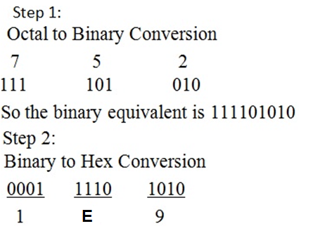
Conversion between Number Systems
Octal to Hexa (Contd…)
Octal → Binary → Hexa

Slide 40
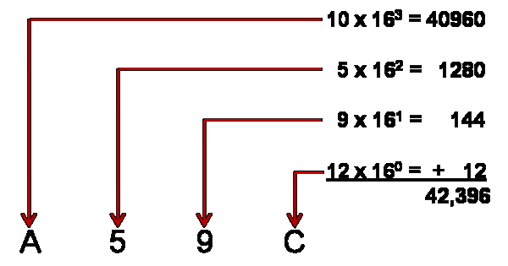
Conversion between Number Systems
Hexa to decimal

Slide 41
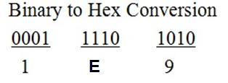
Conversion between Number Systems
Hexa to binary

Slide 42
Binary representation of integers
Binary equivalent of the integers are stored in memory including one additional bit for representing the sign of integers (positive or negative).
If the binary equivalent of the integer includes one additional bit for representing its sign, that binary number is called signed binary number.

Slide 43
Binary representation of integers
There are three ways for representing the positive and negative integers into its binary equivalent.
Sign magnitude representation
One’s Complement
Two’s Complement

Slide 44
Binary representation of integers
Sign magnitude representation
In the sign magnitude representation, positive number have a additional bit (sign bit) 0, while the negative number has a sign bit 1, while the magnitude is a simple binary equivalent of the number.
E.g. +5 and -5 can be representing in 6 bit register as:
+5 = 0 00101 and -5 = 1 00101

Slide 45
Binary representation of integers
Note: In every representation technique , the representation of positive number is identical to that used in the sign magnitude system i.e simple binary form including sign bit 0.

Slide 46
Binary representation of integers
2. One’s Complement representation
In one's complement, positive numbers are represented as usual in signed magnitude. However, negative numbers are represented differently. To negate a number, replace all zeros with ones, and ones with zeros - flip the bits.
+12 = 0 0001100, and -12 = 1 1110011.

Slide 47
Binary representation of integers
3. Two’s Complement representation
In two's complement, positive numbers are represented as usual in signed magnitude. However, negative numbers are represented by adding 1 in magnitude part of one’s complement.
+12= 0 0001100
-12 = 1 1110011 (1’s complement)
-12 = 1 1110100 (2’s complement)

Slide 48
Binary Addition
Rule for Binary Addition:
0 + 0 = 0
0 + 1 = 1
1 + 0 = 1
1 + 1 = 0 (Carry 1)

Slide 49
Binary Addition
Example:
Add 110101 and 101111
1 1 0 1 0 1
1 0 1 1 1 1
1 1 0 0 1 0 0
1
1
1
1
1
1

Slide 50
Binary Addition
Example:
Add 10110 and 1101
1 0 1 1 0
0 1 1 0 1
1 0 0 0 1 1

Slide 51
MINGGU DEPAN UTS
OFF LINE
KERTAS ESSAY
INDIVIDU
MATERI DARI PERTEMUAN 1 HINGGA PERTEMUAN 8

